Slide 2
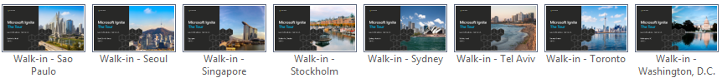
City-specific walk-in slides
This template contains specific walk-in slides for each city visited by the Ignite Tour.
To choose the correct walk-in slide:
Go to the Home tab.
Click the down arrow next to New Slide.
Scroll down on the list of available layouts and choose the layout that matches the desired city; for example, the layout called “Walkin - Amsterdam” if your presentation is to be given in Amsterdam.
If you’d like to keep the file size down once you have selected your city walk-in, you can go into the master and delete the walk-in slide masters you are not using. Go to the “View” tab, click on “Slide master,” 6 options from the left, navigate to the master walk-ins, select the masters you are not using, and hit delete.

Slide 3
Investing in Serverless: Less Servers, More Code
Jeremy Likness
Notes:
Let’s take a minute to talk about a trend I’m confident many of you have heard of but might not agree on what it really means. “Serverless.” It turns out that serverless is a tool we can use to be successful with Trailwind Traders and I’m going to show you why and how.

Slide 4
Introduction to Serverless
Notes:
First, I want to step back and make sure we’re on the same page with understanding what serverless means.

Slide 5
What is the right size of
servers for my business needs?
How do I deploy new code to my server?
What media should I
use to keep backup?
What happens in case of
server hardware failure?
Which packages should be on my server?
What size of servers
should I buy?
Who monitors
my App?
How often should I backup my server?
How can I scale my app?
How can I increase server utilization?
Who has physical
access to my servers?
Which OS should I use?
Do I need secondary network connection?
Are my server in a
secure location?
What happens if the
power goes out?
Who monitors
my Servers?
Do I need a UPS?
What storage I need to use?
How many servers
do I need?
How can I dynamically configure my app?
It takes how long to provision a new server?
How often should
I patch my servers?
On-Premises
The “evolution” of application platforms
Notes:
There is so much talk about the cloud that sometimes it’s easy to forget it all began (and still exists) in the data center. Fortunately, not many of us have to configure physical servers and install them in the data center. Taking on that responsibility means a lot of questions to answer. Everything from “how do I secure physical access” to “what happens when the power goes out?” These are questions and steps that distract from the focus of building good software but must be addressed for on-premises installations to be successful.

Slide 6
What is the right size of servers for my business needs?
How can I increase server utilization?
How many servers do I need?
How can I scale my app?
How often should I patch my servers?
How do I deploy new code to my server?
How often should I backup my server?
Which OS should I use?
Which packages should be on my server?
Who monitors my App?
On-Premises
IaaS
The “evolution” of application platforms
Notes:
Fortunately virtualization came to the rescue. One great thing about the cloud evolution is that each phase leads to less waste. Infrastructure as a Service leverages hardware in a way that you can stop worrying about the hardware and focus on the operating system and your virtual machines. You can get better utilization of your resources and it’s faster and easier to provision new instances. IaaS addresses many of the questions we dealt with on-premises, and more importantly paves the way to the cloud.

Slide 7
What is the right size of “servers” for my business needs?
How can I increase “server” utilization?
How many “servers” do I need?
How can I scale my app?
On-Premises
IaaS
PaaS
The “evolution” of application platforms
Notes:
Platform-as-a-Service is the next evolution: host a runtime, so we stop worrying about hardware and operating system and even dependencies and just focus on our project. We’re no longer in the business of constantly patching an OS or even making sure dependencies are installed to run a web server or host a process. PaaS simplifies the process even more and provides a mature platform for code that must run at scale because you can still size (scale up) and specify instances (scale out) to manage your workloads.

Slide 8
How do I architect my app?
Serverless, the platform for cloud native apps
On-Premises
IaaS
PaaS
Serverless
The “evolution” of application platforms
Notes:
Serverless takes us to the ultimate cloud native experience: we simply focus on code. It doesn’t mean there is no server, because we still need to run on infrastructure, but the infrastructure is further abstracted so there is less server in our scope of responsibility and more code. We focus on what is unique for our business and spend more time on innovation, less time on answering the myriad questions that exist with the previous phases. Serverless is cloud native. But what does that really mean?

Slide 9
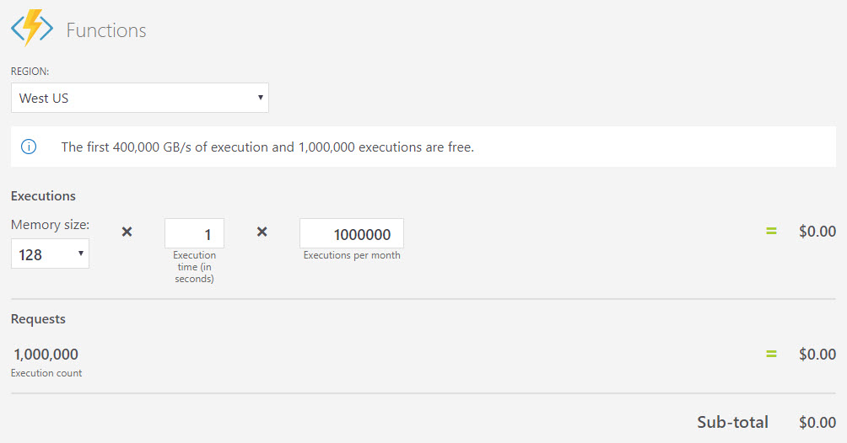
What is Serverless?
$
Abstraction of servers
Event-driven/ instant scale
Micro-billing
Notes:
With serverless, the server, including hardware, infrastructure and configuration of the operating system are all abstracted away. You don’t even have to worry about a web service because it’s provided as part of the platform.
Serverless compute is a fully managed service. Some refer to it as Functions as a Service
OS and Framework patching is performed for you
There is zero administrative tasks and no need to manage any infrastructure
You just deploy your code (function) and it runs
Your code runs within seconds and for typically shorter periods of times (minutes vs. hours or days)
Serverless compute scales quickly (almost instantly) and vastly
Automatically scales within seconds
No scale configuration is required (there is no way to configure scale or limits)
Scales to match any given workload. Scales from zero to handle tens of thousands concurrent functions invocations within seconds
Pay only for the time your code is running
Serverless compute reacts to events
React, in near real-time, to events and triggers
Triggered by virtually any event from both inside and outside of Azure
A key differentiator about serverless is micro-billing. Serverless resources are billed only when used. That means that you aren’t paying to anticipate an increase in workload, but only when the workload hits. Serverless scales with your business. Let’s take a closer look at micro-billing.

Slide 10
What is Serverless?
$
Micro-billing
Notes:
This is a pricing calculator showing the cost to execute functions, or serverless code, 1 million times in a month. You aren’t seeing things: the cost is zero. Functions bill based on two factors: number of times your code is called, and how much memory is consumed during a call. The “GB/s” measurement is just the total memory consumed over time by your function. Functions that require a high amount of memory or run longer therefore cost more than functions that consume little memory or execute in a short period of time. This factor can help determine whether your code is a candidate for serverless.

Slide 11

What is Serverless?
$
Micro-billing
Notes:
Here we’ve upped the number of invocations. We now are calling 5 million functions in a month that consume 128 megabytes of memory and run for a full second. I hope most of your functions run faster, I know mine are usually measured in milliseconds. Even with the slower time and moderate memory consumption, 5 million calls costs less than $5 US dollars.

Slide 12
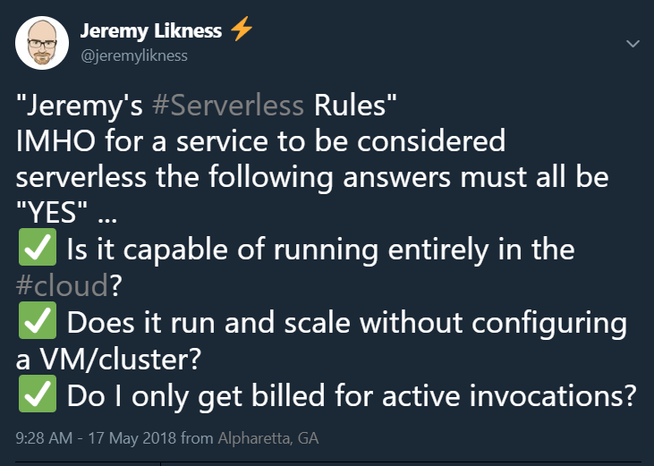
What is Serverless?
$
Micro-billing
Notes:
Micro-billing is so important I believe it should be a requirement for a service to be considered serverless. There is no official definition of serverless, so here’s a tweet because we know everyone on the Internet is true. If you pay regardless of whether your code is running, that’s a fully managed service and not necessarily serverless.

Slide 13
Scanning a SKU
Server
Notes:
Let’s jump into an example. At Tailwind Traders we track inventory by an identifier called a SKU. A SKU may be “scanned” in a store for information, or referenced from the web page. Let’s assume I have a service that is called every time a SKU is scanned to check Tailwind’s inventory system. This works fine for a few scans, but when multiple scans come in a single service can get overloaded.

Slide 14
Scanning a SKU
Server
Server
Server
Server
Notes:
What we really want is something that will automatically spin up new instances and even distribute the load. Let’s see what that looks like.

Slide 15
Serverless for Elastic Scale
Demo One
Notes:
Demo #1

Slide 16
Functions by the numbers.
ActiveUsers
Apps
Daily Runs
Over 40,000
Over 275,000
Over 2.9 Billion
Notes:
Hopefully you are starting to see some of the value inherent in the serverless approach. Serverless is being widely adopted, and on Azure alone we have 40,000 active users responsible for almost 3 billion function executions every day!

Slide 17
Azure serverless platform components
Functions
Execute your code based on events you specify
Notes:
Functions aren’t the only serverless solution. The Azure serverless platform contains several components. We’ve looked at functions, but there are other services as well that we’ll explore deeper.

Slide 18
Azure serverless platform components
Logic Apps
Functions
Design workflows and orchestrate processes
Execute your code based on events you specify
Notes:
Logic apps are workflows and integrations that connect cloud services together, make decisions and run code, all with a visual designer. Like functions, logic apps are triggered by events and only bill when there are being run.

Slide 19

Azure serverless platform components
Event Grid
Logic Apps
Functions
Manage all events that can trigger code or logic
Design workflows and orchestrate processes
Execute your code based on events you specify
Notes:
Event grid is a service that enables a publisher/subscriber model at web scale. It allows you to both generate and consume events from inside and outside of Azure to coordinate events across the enterprise.

Slide 20






Azure serverless platform components
Platform
Event Grid
Logic Apps
Functions
Manage all events that can trigger code or logic
Design workflows and orchestrate processes
Execute your code based on events you specify
Database
Storage
Security
IoT
Analytics
Intelligence
Notes:
All of these services interoperate seamlessly with other Azure platform components, including databases like Azure SQL and Cosmos DB, storage services, security and identity, IoT, analytics, and even artificial intelligence. We’ll explore a machine learning integration later on.

Slide 21
Azure serverless platform components
Development
Platform
IDE support
Event Grid
Logic Apps
Functions
</>
Manage all events that can trigger code or logic
Design workflows and orchestrate processes
Execute your code based on events you specify
Integrated DevOps
Local Development
Monitoring
Database
Storage
Security
IoT
Analytics
Intelligence
Visual Debug History
Notes:
Of course developers want to be able to develop and test services locally, without an Internet connection, integrate these services with a mature DevOps pipeline and be able to both monitor and debug services that are already deployed to production. All of the Azure serverless platform components plug into your favorite development environment and enable local testing and remote debugging and telemetry.

Slide 22




Introducing Functions
Code
Azure Functions
Events
Notes:
The first example you saw was functions. Functions are literally code and events. And now I’ve revealed a carefully guarded secret: you know where the functions logo came from!

Slide 23
Functions Secret Sauce: Triggers and Bindings
Triggers
Blob Storage
Cosmos DB
Event Hub
HTTP
Queues
Service Bus
Timer
Webhook
Bindings
File
Table
Excel
OneDrive
Email
Mobile app
Notification
More…
Notes:
Although functions are great because they run at scale and only bill when they are active, the “secret sauce” is in triggers and bindings. This is what made it so easy to access the data from table storage and respond to a web event. Instead of standing up a web server, we simply wrote code that responded to a web trigger and were passed a class with all of the information we needed. Instead of scanning for a connection string, opening a database connection, and navigating to table, our binding passed us a class that was already primed to interact with table storage. There are dozens of triggers and bindings available and you can write your extensions as well.

Slide 24
Scenarios
Eve
r
y 15 minutes
Find and clean invalid data
Clean table
File added to
T
ransfo
r
m CSV to data
r
ows
P
ower BI
Blob Storage
Cha
r
t graphic
Notes:
Here are some of the scenarios we see serverless being used for. Have you ever had to find a scheduling service or install a special service just to run a job at a regular interval? You can trigger functions with a timer trigger and do things like purge expired web sessions from a table. Another common scenario is to trigger a function based on a blob storage event. For example, an ETL process may upload a CSV file that is then parsed, transformed into database rows and then analyzed with a Power BI dashboard.

Slide 25
Scenarios
Photo taken and
Sto
r
es in blob storage
P
r
oduces scaled images
W
ebHook called
Loaded web page
C
r
eate ad based on user profile
Completed page
calls
W
ebHook
Notes:
Another scenario might trigger from a photograph that is uploaded and this triggers code that automatically generates thumbnails. The last scenario is my personal favorite. You visit a web page, the page calls a function with your user profile and this gathers all of the data collected to deliver a personalized ad. This is why you do a web search for smart thermostat and suddenly see IoT ads everywhere you visit.

Slide 26
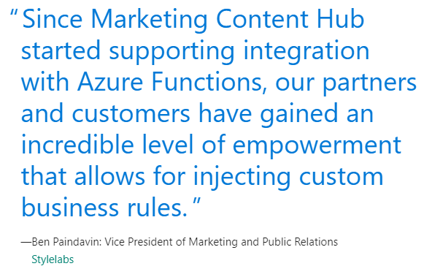
Case Studies

Slide 27
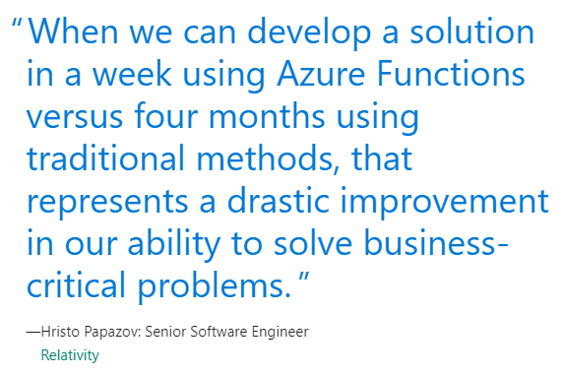
Case Studies

Slide 28
Enterprise Messaging with Event Grid
Notes:
It’s great we have a SKU query that scales, but we need more. One thing that is important to Tailwind Traders is messaging. When a new inventory item is added, there are many systems that need to be notified. A SKU also has its own lifecycle: it needs to have an image uploaded, a description added, and an appropriate price set. The website needs to know when a price is set, but down the road we may open a brick and mortar store with its own Point of Sale system. We want an infrastructure to publish events without having to be directly coupled to other systems, and as we add more systems they should simply be able to subscribe to events to use them.

Slide 29











Modern computing is all about events
Notes:
In the past, managing events was hard. Some of you have built systems that involved multiple servers, load balancers, clustered message queues and database backends just to ensure that you can manage messages at scale across the enterprise.

Slide 30
?
Managing events is important but cumbersome
?
?
?
?
?
?
?
?
?
?
?
Notes:
Dealing with your own events infrastructure can be complex and cumbersome. It requires a lot of investment and a lot of work. It can also involve a lot of waste. I know of projects that would add a dozen servers in anticipation of a new customer just in case because they didn’t have a good way of knowing what workloads to expect.

Slide 31

What if all these events could be managed and directed from one place?
Notes:
What would be great is to have one centralized service that handles all of the infrastructure and scale out, so we can focus on what’s unique to our business which is the messages themselves.

Slide 32
Azure Event Grid
Fully-managed event routing
Near real-time event delivery at scale
Broad coverage within Azure and beyond
Backbone of event-driven computing
Notes:
Event grid provides this service. It’s fully managed event routing. It provides near real-time event delivery at scale, and I’ll tell you what “near real-time” and “scale” mean with precise numbers in a moment. Event grid works seamless inside of Azure but also is designed to work with third-party platforms and tools. It provides a backbone for event-driven computing.

Slide 33
Benefits
Focus on innovation and pay per event
Ensure reliability and performance for your apps
Unlock new scenarios for your apps
Manage all events in one place
Notes:
At Tailwind Traders, we don’t have to waste time managing severs and preparing to scale. Instead, we focus on innovation. We pay by event so the service scales with our business. We don’t have to invest in backups and redundant servers because the reliability and performance is provided by event grid. This let’s us focus on scenarios in our apps that would have been delayed waiting on infrastructure. The best part is with event grid we can manage all of our events in one place.

Slide 34
But Wait … What About?
Event Hubs
“Point in time” data
Fast pull
Replay / strict ordering
Big data streams
Notes:
Before I show you how messaging works, I want to clarify how it compares with other Azure services that are similar. The first is event hubs. Event Hubs are designed for point in time data. They deal with big data streams. I can request a playback of a stream for a particular duration of time and know the events will be played back in a strict order.

Slide 35
But Wait … What About?
Event Hubs
Service Bus
“Point in time” data
Fast pull
Replay / strict ordering
Queue for critical items
Routing
Workflow
Transactional
Big data streams
Notes:
On the other end of the spectrum is service bus. This is where I route critical items. I can set up complex workflows and transactions (in other words, if three things have to happen but one of them fails, I can roll back the entire transaction).

Slide 36
But Wait … What About?
Event Hubs
Event Grid
Service Bus
“Point in time” data
Fast pull
Replay / strict ordering
Business logic
Push, not poll
Handlers
Guaranteed delivery
Queue for critical items
Routing
Workflow
Transactional
Big data streams
Notes:
Event Grid sits in the middle. It is meant for business logic. What’s unique is that event grid doesn’t store message to be polled, but operates on a push model. It pushes messages out to handlers. It does guarantee delivery, so if a handler is temporarily down it will pick up missed messages when it comes back up.

Slide 37
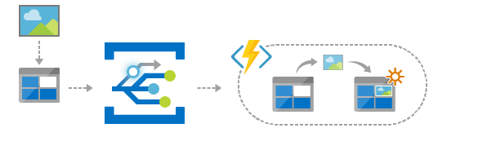
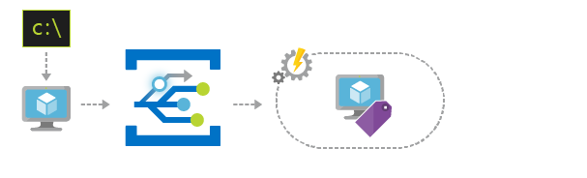
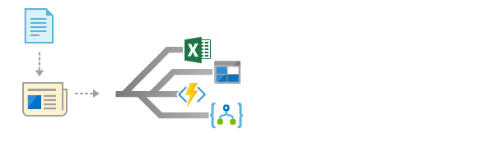
Scenarios
Serverless apps
Ops automation
Application integration
Instantly trigger a serverless function to run analysis when a new file is added to a blob storage container.
Speed up automation and simplify policy enforcement by notifying Azure Automation when underlying infrastructure is provisioned.
Connects your app with other services. Create an application topic to route your app’s event data to any desired destination.
Notes:
To better understand event grid, there are three common scenarios it is used. The first is as the messaging framework for serverless apps. Resources can generate events that trigger functions and logic apps. Another scenario is ops automation. For example, creating a resource group can send an event that triggers setting up a standard security policy or populating the resource group with a set of standard assets. Finally, a common scenario is integrations behind apps, both current and legacy.

Slide 38







Manage all events in one place
Event publishers
Event handlers
Blob Storage
Azure Functions
Resource Groups
Logic Apps
Azure Subscriptions
Azure Automation
Event Hubs
WebHooks
Custom Events
Notes:
All of our events are managed centrally. This includes Azure specific events like uploads to blob storage, changes to subscriptions, etc. but also third-party apps that generate custom events. On the other end, many Azure resources are designed to consume event grid events directly, but it is also possible to send them to a web hook you can build in any language on any platform that is capable of processing web requests.

Slide 39
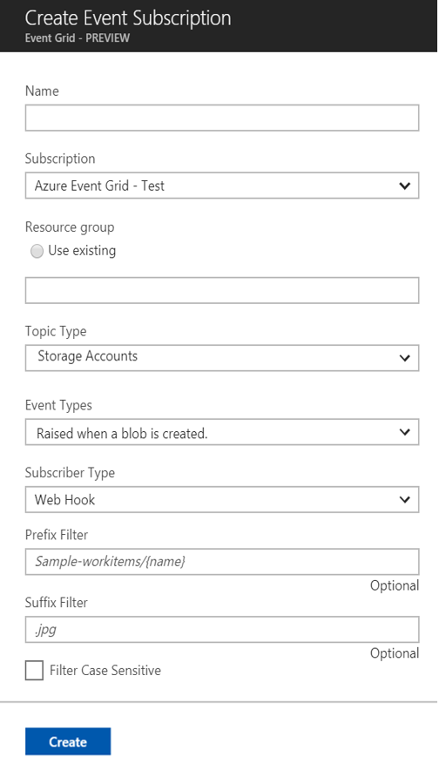
Manage all events in one place
Event publishers
Event handlers
Subscribe to pre-defined system events in Azure or create your own custom topics
Route events to any end-points, Azure or even beyond
Enable filtering and efficient routing of events
Notes:
This is an example of a subscription. It can listen to events generated in Azure or through a custom channel, then route them to an endpoint. It is also to filter events so handlers only receive events they were designed to process.

Slide 40
Ensure reliability and performance in your apps
Sub-second end-to-end latency in the 99th percentile
10,000,000 events per second per region
24-hour retry with exponential back off for events not delivered
Near real-time
Massive scale-out
High reliability
99.99% availability
100,000,000 subscriptions per region
Transparent regional failover
Notes:
I mentioned earlier I would explain the metrics in more detail. Event grid guarantees delivery in less than a second at the 99th percentile. That is what near real-time means. If you need a millisecond respond then event grid is probably not the right solution but for near real-time message delivery it is perfect. That is because it also guarantees that it can handle 10 million events per second per region, and will guarantee delivery in a 24 hour window. It also provides a 99.99% uptime guarantee, can handle 100 million subscriptions per region and will failover to other regions transparently in the case of an outage.

Slide 41
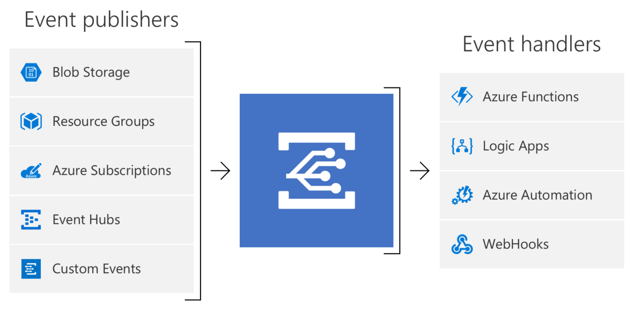
Concepts
Events: what happened
Event Publishers: where it took place
Topics: where publishers send events
Event Subscriptions: how you receive events
Event Handlers: the app or service reacting to the event
Notes:
We built Tailwind Traders to take advantage of event grid. First, let’s level set on some terms. (Main thing to call out is that unlike a queue that typically removes the item when it is popped by the first consumer, event grid messages are delivered to ALL subscribers.)

Slide 42
SKU Events
Monitor
Add
Set Price
Notes:
This is an example of what happens at Tailwind Traders when a SKU is added. Adding a SKU raises an “add” event. We wrote a monitor we can use to monitor events and we’ll hook into these same events to something more interesting a bit. After the SKU is added, someone may come back and set the price. This raises a separate event that is caught by the same monitoring function.

Slide 43
Event Grid and Azure Functions
Demo Two
Notes:
Demo #2

Slide 44
Durable Functions for Long Running Workflows
Notes:
Of course, it’s not very practical to watch a monitor all day long for events to come through. We use these events to move an inventory item through its lifecycle. For a SKU to become active in our inventory, several events need to happen. We wrote a simple function to monitor for these events using a special feature called durable functions.

Slide 45
Durable Functions
Stateful workflows
Workflows in code (not designer)
Synchronous and asynchronous
Checkpoints and halts
Orchestration
Notes:
Durable functions allow us to write stateful workflows in code. This allows several scenarios we’ll get to in a minute. What is great about durable functions is that they are designed to save state when a function is waiting on another event, then restore state when the event completes. This means you aren’t billed for the function while it is waiting on asynchronous calls to complete. This opens up a number of possibilities.

Slide 46
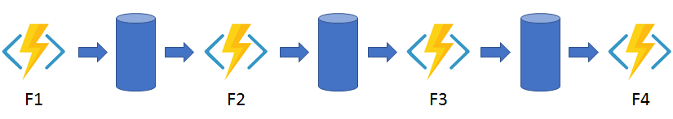
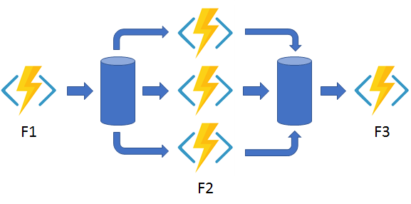

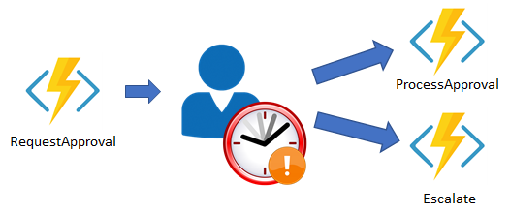
Durable Functions Patterns
Sequential Asynchronous Calls
Fan out / Fan in
Ongoing Monitoring
Human Approval
Notes:
Here are some of the things we can do with durable functions: manage asynchronous sequential workflows and not get billed while waiting for the calls to return, fan-out/fan-in scenarios where we asynchronously wait for several things to complete before moving onto the next step, manual process with timeout so we can do things like escalate approvals if they are taking too long, and finally a lot of blue arrows going into a swirlie. Just kidding, another scenario is a long running task that provides monitoring information.

Slide 47
SKU Lifecycle
Description Set
Added
Price Set
Set Active
Done
Image Set
Notes:
For our SKU to go active, we want to ensure it has an image, a description, and a price. Our durable workflow is kicked off when the SKU is added, then waits for the other events to happen in any order, then finally sets the SKU to active once all conditions have been satisfied. Let’s see what that looks like in code!

Slide 48
Durable Serverless Workflows
Demo Three
Notes:
Demo #3

Slide 49
Integrations Made Easy with Logic Apps
Notes:
Now we have a good workflow, but the great thing about messages is that we can easily subscribe to the same message and kick off different workflows in response. We have some more work to do with our SKU, and to get it done we’ll use logic apps.

Slide 50
Introducing Azure Logic Apps
Powerful Integration and Workflow Engine born in Azure
Fast integrations using a visual designer and workflow creation with triggers and actions
Connect applications, data and services
Connect and orchestrate Azure Functions
Notes:
Logic apps is an integration and workflow engine. It started conceptually with BizTalk server and is built on nearly two decades of experience. Logic Apps is a re-imagining of BizTalk as 100% cloud native on Azure with the goal to enable integrations in days or even hours that used to take weeks or even months.

Slide 51
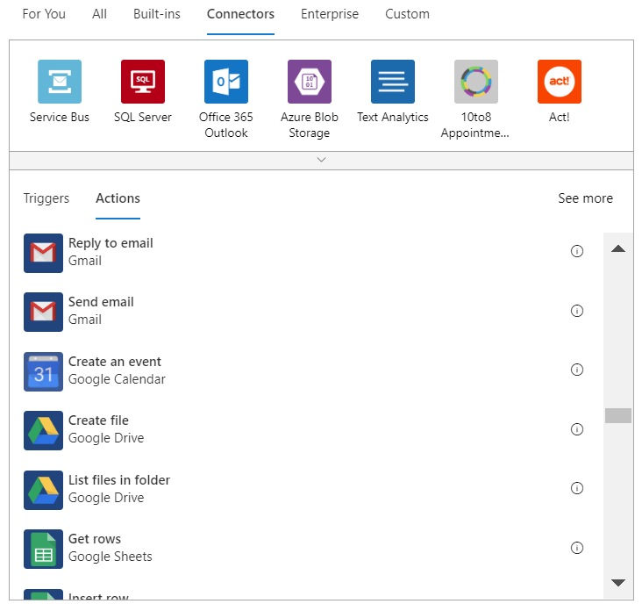
Hundreds of Connectors for Integrations
Notes:
Logic Apps have literally hundreds of integrations and support for custom integrations as well. You are able to integrate with Azure resources, database servers, SharePoint installations, Office 365, Dynamics, or third party resources like gmail, Twilio for text messaging or Slack for real-time communication.

Slide 52
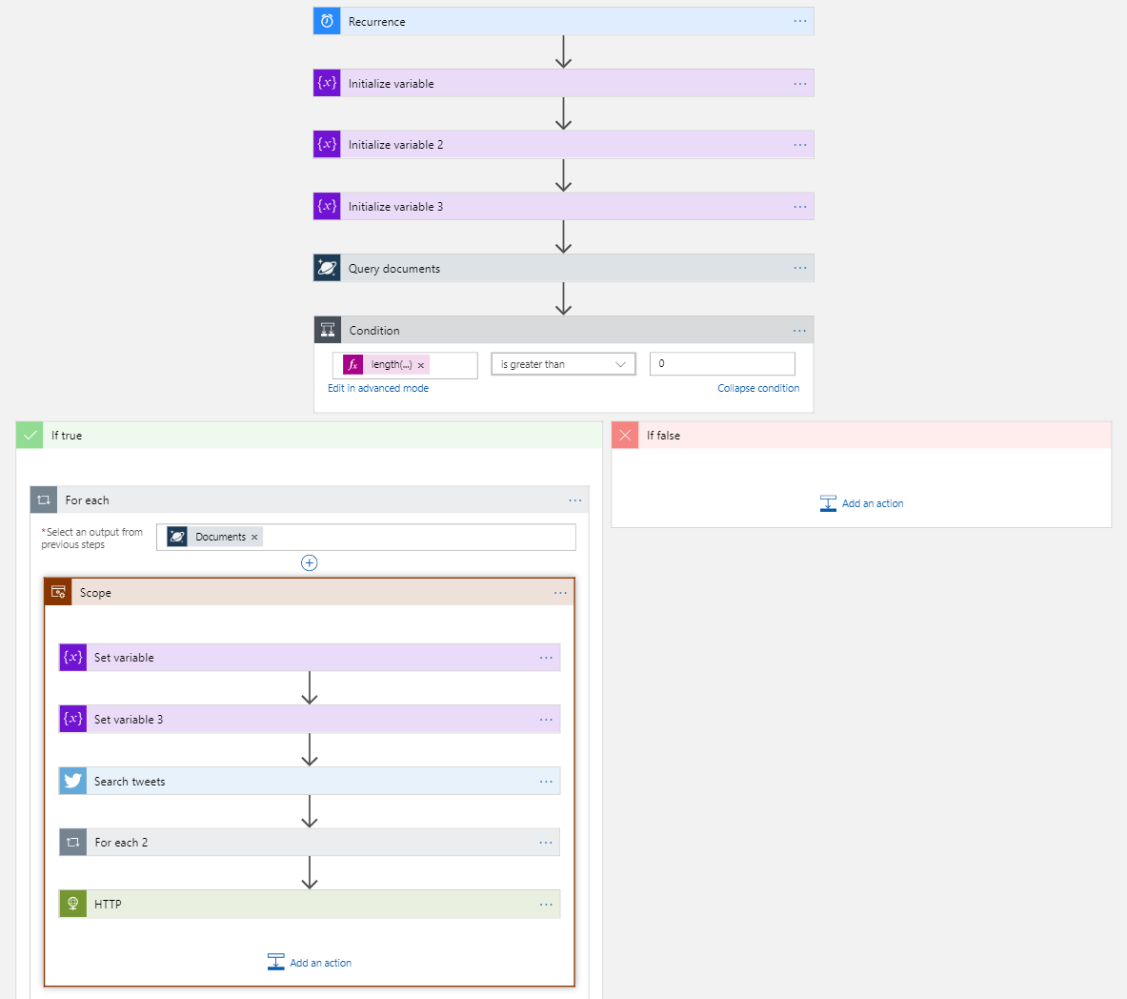
Visual Workflow Designer
Notes:
The integrations and workflows are all done within a visual designer that makes it easy to integrate, but also loop and branch on decisions so that you can manage different scenarios and edge cases.

Slide 53


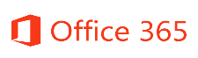








Logic Apps connects everything
Azure Functions
Service bus
Cognitive services
Logic Apps
Machine learning
On-premises data gateway
BizTalk server
Notes:
Logic apps are great at connecting resources across the cloud, but they are also capable of integrating with on-premises resources with the on-premises data gateway. That means you can, for example, kick off a workflow in the cloud that results in the execution of a store procedure on your SQL database tucked away in your corporate data center.

Slide 54
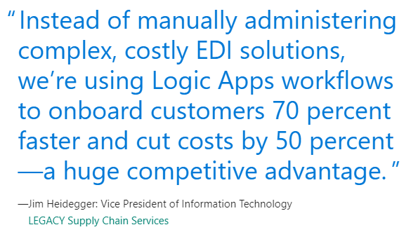
Case Study

Slide 55
Logic Apps Integrating Event Grid and Email
Demo Four
Notes:
The first thing we wanted to do is email a distribution list when a new SKU is added. This informs our staff of the addition and lets them know they can start looking at adding images, researching prices, etc. Let’s take a look at how that works. Demo #4

Slide 56
Logic Apps Integrating Machine Learning
Demo Five
Notes:
As Tailwind Traders has grown, the amount of inventory we ingest is enormous. Although we always want accurate descriptions, it would be nice to automate some of the process for the sake of reporting and early touch points with inventory. Wouldn’t it be great if we could tap into a resource that “looks” at the image we upload and automatically generates a description for us? We can then review it and update it as necessary. Let’s see what it takes to listen to the image event and use Cognitive Services feature called Computer Vision to automate creating a description. Demo #5

Slide 57
Next steps
Get session presentations
http://aka.ms/MyMSIgniteTheTour
Get session code on GitHub
http://aka.ms/MSIgniteTheTourCode

Slide 58
Thank you.
Notes:
As you can see, we were able to accomplish a lot at Tailwind Traders without investing in any hardware. We are able to scale our SKU inquiries automatically, and what’s great is that we pay almost nothing in the off season when activity is slow. When the usage is high it’s because we’re making sales and can afford a little extra expense to ensure a consistent and satisfactory experience for the customer. We were able to plug in messaging and integrate with our corporate email using nothing more than a visual designer. Thank you for your time and attention to learn a bit about how serverless works to scale the enterprise with cloud native solutions.

Slide 59
Text layout (without bullet points)
Main topic: Segoe UI Semilight, size 28pt
Segoe UI, size 20pt for second level
Segoe UI, size 16pt for third level

Slide 60
Text layout with bulleted text
Main topic: Segoe UI Semilight, size 28pt
Segoe UI, size 20pt for second level
Segoe UI, size 16pt for third level

Slide 61
Example with longer headline text wrapping to a second line
When the headline text is 2 lines, move this text block down to align to the lower blue guide
If you don’t see guidelines, click on the View menu, and then check the box in front of “Guides”
Use a “soft return” Shift + Enter to wrap text without adding extra line spacing

Slide 62
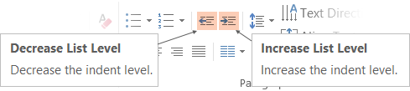
Adjusting list levels
Main topic: Segoe UI Semilight, size 28pt
Segoe UI, size 20pt for second level
Segoe UI, size 16pt for third level
Use the “Decrease List Level” and “Increase List Level” tools on the Home menu to change text levels.
Try this:
Place your cursor in the line of text that says “Segoe UI, size 20pt for second level”
Next click the Home tab, and then on the “Decrease List level” tool. Notice how the line moves up one level.
Now try placing your cursor in one of the top “Main topic…” line of text. Click the “Increase List Level” tool and see how the text is pushed in one level.
Use these 2 tools to adjust your text levels as you work

Slide 63
Bullet points layout with subtitle Set the subtitle to 20pt in the same text block, with character spacing Normal
Move the text block down vertically to align to lower guide
If you don’t see guidelines, click on the View menu, and then check the box in front of “Guides”
Hyperlink style: www.microsoft.com

Slide 64
Square photo with title
Smaller text

Slide 65
Square photo layout with smaller text

Slide 66
Slide palette info
The PowerPoint palette for this template has been built for you and is shown below.
Avoid using too many colors in your presentation.
PowerPoint Theme Accent colors
Accent 1
Accent 2
Accent 3
Accent 4
Accent 5
Accent 6
Use Accent 1 as the main accent color.
Use Accent 2 and Accent 3 only when additional colors are needed.
Use Accents 4-6 sparingly

Slide 67
Attention: PLEASE READ
Photography and copyright infringement.
Using imagery from movies, television, music and pop-culture is illegal, unless purchased, licensed or by express written consent from the owner. Please do not include unlicensed imagery in your presentation.
Sessions with questionable imagery will not be published until resolved. The speaker will be contacted via email for immediate resolution. If additional costs are incurred in editing, an I/O Code will be required.
If you have any questions regarding your imagery please contact Media Acquisitions
Music Sound Video Acquisitions: MuSoVidAcq@microsoft.com
The PPT deck and Recording will not be published until the editing is complete.

Slide 68
Common copyright myths
If an image is on the Internet/Bing it is in the public domain.
If there is no copyright notice on the image, I don’t need permission.
If I don’t profit from the use, I don’t need permission.
If I remove the image after notice, I don’t owe any money to the copyright.
If I alter the image a certain percentage, I don’t need permission.
If I only use a part of the image, I don’t need permission.
If I only include a hyperlink in my presentation and click it to show the image, I don’t need permission.

Slide 69
Resources for Microsoft employees
A few great places for imagery and information
Brand Central: A resource for information on the Microsoft brand
https://microsoft.sharepoint.com/teams/BrandCentral/
Microsoft News Center A great place for the latest and greatest
www.microsoft.com/en-us/news
Xbox Wire Media Assets library
http://news.xbox.com/media/
Featured Devices: PC, tablet and phone hardware imagery and marketing materials
https://www.featureddevices.com/
Presentation Resources: Presentation guidelines and PowerPoint templates
https://microsoft.sharepoint.com/teams/BrandCentral/Pages/Presentations.aspx
Respect intellectual property rights
Photography and graphics used in presentations, for both internal and external audiences, must be owned by Microsoft or licensed appropriately.
Microsoft has agreements in place with several stock providers. Contact Media Acquisitions for more information.
Media Acquisitions
www.superstock.com/
www.gettyimages.com/creativeimages/royaltyfree
Avoid intellectual property theft: Do not use photos or graphics copied from the web in presentations. When in doubt, consult with CELA.

Slide 70
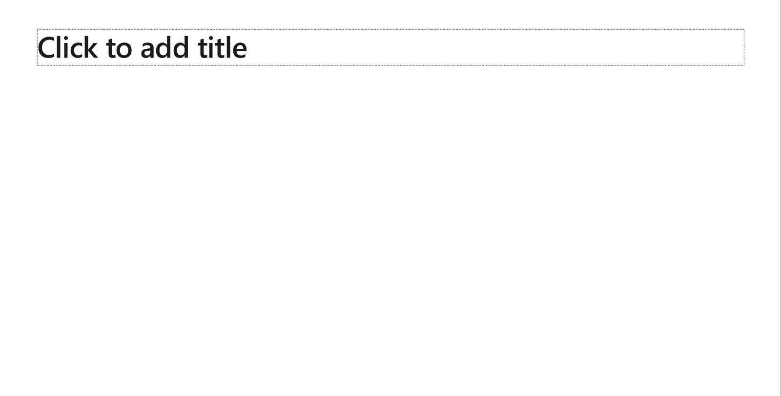
Creating accessible content
Take the following steps to create accessible content that everyone can consume effectively.
Contrast
Use high contrast colors for maximum readability
The recommended contrast ratio is at least 4.5:1
Shape and color
Use different shapes with a legend to indicate statuses to accommodate for color blindness
Example:
Alt text
Alt text helps people with screen readers understand the content of slides
You can create alternative text for shapes, pictures, charts, tables, SmartArt graphics, or other objects
Here’s how:
Right click the image or shape
Select Format Picture… or Format Shape…
Select the Size & Properties icon
Expand the Alt Text field
Enter a Title and Description of your image or object
Slide layouts
Using a built-in slide layout that matches your content ensures a hierarchical reading order of text blocks
Example:
If a new slide will have a title, rather than starting with a blank layout and adding a text block for the title, choose one of the built-in layouts with a title placeholder
Reading order
Screen readers describe content on the screen in the order it was created
To ensure your content is read back in the order you prefer, arrange your objects in the Selection Pane appropriately. Objects on the bottom of the selection pane are read first
Here’s how:
Click the Home tab
In the Drawing group, select the Arrange drop-down menu
Click Selection Pane…
Text
Text
Text
Subject 1
Subject 2
Subject 3
Color Contrast Analyzer
Download this tool to determine the legibility of text and the contrast of visual elements
Download
C1
C2
C3
Additional tips
Be sure to run the Accessibility Checker! Go to File click the Check for Issues drop down menu click Check Accessibility
Videos need to be accessible: If your presentation includes a video, ensure it is captioned and audio described (if appropriate)
Visit the Office Accessibility Center to learn more about accessibility in PowerPoint

Slide 71
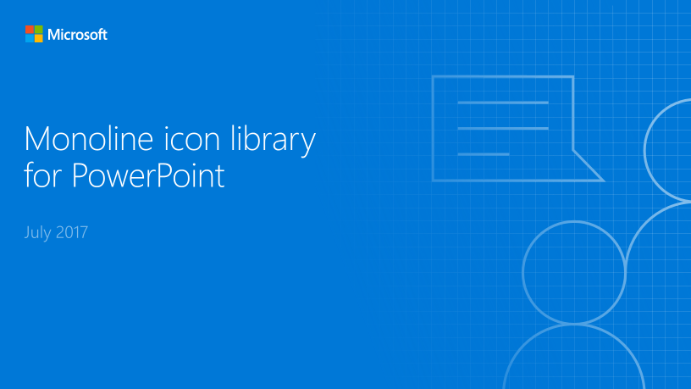
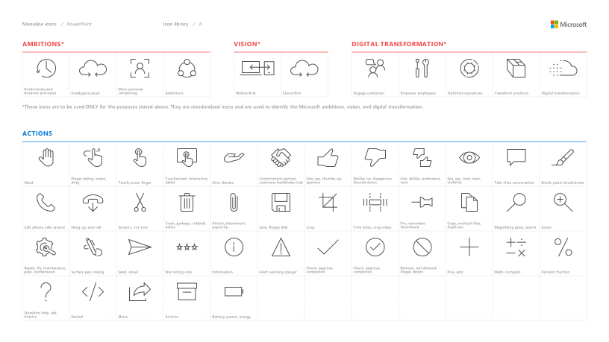
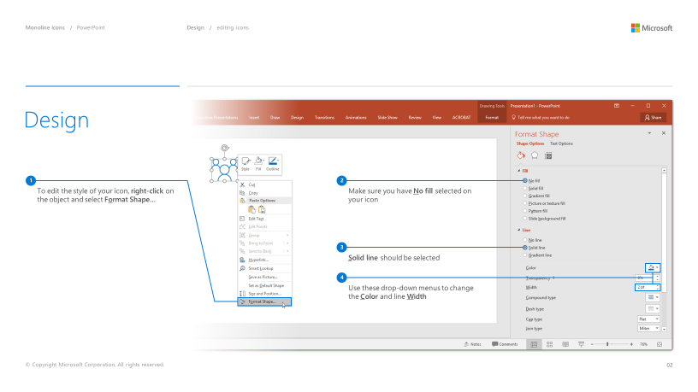
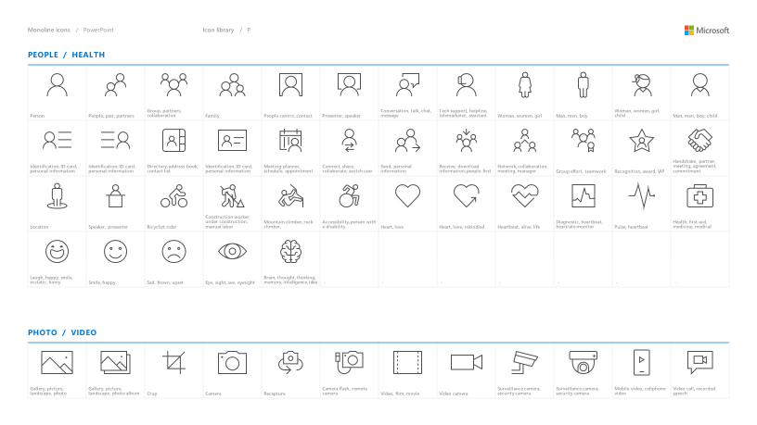
Microsoft monoline icons
Looking for icon resources?
The Monoline icon library for PowerPoint is a slide deck that provides a library of icons for use in PowerPoint presentations.
The Monoline icon style guide for PowerPoint is a pdf with additional guidelines.
Download both from Brand Central.

Slide 72
Demo
Speaker name

Slide 73
Video

Slide 74
Section title

Slide 75
Software code slide
This slide layout uses Consolas, a monotype font which is ideal for showing software code.

Slide 76
Notes (hidden)
Some speakers at Microsoft like to use this slide for hidden “notes slides”.
Delete it if you don’t want to use it.
NEXT: <next slide title>

Slide 78
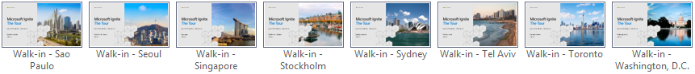
City-specific walk-in slides
This template contains specific walk-in slides for each city visited by the Ignite Tour.
To choose the correct walk-in slide:
Go to the Home tab.
Click the down arrow next to New Slide.
Scroll down on the list of available layouts and choose the layout that matches the desired city; for example, the layout called “Walkin - Amsterdam” if your presentation is to be given in Amsterdam.
If you’d like to keep the file size down once you have selected your city walk-in, you can go into the master and delete the walk-in slide masters you are not using. Go to the “View” tab, click on “Slide master,” 6 options from the left, navigate to the master walk-ins, select the masters you are not using, and hit delete.

Slide 79
Presentation title
Subtitle or speaker name

Slide 80
Text layout (without bullet points)
Main topic: Segoe UI Semilight, size 28pt
Segoe UI, size 20pt for second level
Segoe UI, size 16pt for third level

Slide 81
Text layout with bulleted text
Main topic: Segoe UI Semilight, size 28pt
Segoe UI, size 20pt for second level
Segoe UI, size 16pt for third level

Slide 82
Example with longer headline text wrapping to a second line
When the headline text is 2 lines, move this text block down to align to the lower blue guide
If you don’t see guidelines, click on the View menu, and then check the box in front of “Guides”
Use a “soft return” Shift + Enter to wrap text without adding extra line spacing

Slide 83
Adjusting list levels
Main topic: Segoe UI Semilight, size 28pt
Segoe UI, size 20pt for second level
Segoe UI, size 16pt for third level
Use the “Decrease List Level” and “Increase List Level” tools on the Home menu to change text levels.
Try this:
Place your cursor in the line of text that says “Segoe UI, size 20pt for second level”
Next click the Home tab, and then on the “Decrease List level” tool. Notice how the line moves up one level.
Now try placing your cursor in one of the top “Main topic…” line of text. Click the “Increase List Level” tool and see how the text is pushed in one level.
Use these 2 tools to adjust your text levels as you work

Slide 84
Bullet points layout with subtitle Set the subtitle to 20pt in the same text block, with character spacing Normal
Move the text block down vertically to align to lower guide
If you don’t see guidelines, click on the View menu, and then check the box in front of “Guides”
Hyperlink style: www.microsoft.com

Slide 85
Square photo with title
Smaller text

Slide 86
Square photo layout with smaller text

Slide 87
Slide palette info
The PowerPoint palette for this template has been built for you and is shown below.
Avoid using too many colors in your presentation.
PowerPoint Theme Accent colors
Accent 1
Accent 2
Accent 3
Accent 4
Accent 5
Accent 6
Use Accent 1 as the main accent color.
Use Accent 2 and Accent 3 only when additional colors are needed.
Use Accents 4-6 sparingly

Slide 88
Attention: PLEASE READ
Photography and copyright infringement.
Using imagery from movies, television, music and pop-culture is illegal, unless purchased, licensed or by express written consent from the owner. Please do not include unlicensed imagery in your presentation.
Sessions with questionable imagery will not be published until resolved. The speaker will be contacted via email for immediate resolution. If additional costs are incurred in editing, an I/O Code will be required.
If you have any questions regarding your imagery please contact Media Acquisitions
Music Sound Video Acquisitions: MuSoVidAcq@microsoft.com
The PPT deck and Recording will not be published until the editing is complete.

Slide 89
Common copyright myths
If an image is on the Internet/Bing it is in the public domain.
If there is no copyright notice on the image, I don’t need permission.
If I don’t profit from the use, I don’t need permission.
If I remove the image after notice, I don’t owe any money to the copyright.
If I alter the image a certain percentage, I don’t need permission.
If I only use a part of the image, I don’t need permission.
If I only include a hyperlink in my presentation and click it to show the image, I don’t need permission.

Slide 90
Resources for Microsoft employees
A few great places for imagery and information
Brand Central: A resource for information on the Microsoft brand
https://microsoft.sharepoint.com/teams/BrandCentral/
Microsoft News Center A great place for the latest and greatest
www.microsoft.com/en-us/news
Xbox Wire Media Assets library
http://news.xbox.com/media/
Featured Devices: PC, tablet and phone hardware imagery and marketing materials
https://www.featureddevices.com/
Presentation Resources: Presentation guidelines and PowerPoint templates
https://microsoft.sharepoint.com/teams/BrandCentral/Pages/Presentations.aspx
Respect intellectual property rights
Photography and graphics used in presentations, for both internal and external audiences, must be owned by Microsoft or licensed appropriately.
Microsoft has agreements in place with several stock providers. Contact Media Acquisitions for more information.
Media Acquisitions
www.superstock.com/
www.gettyimages.com/creativeimages/royaltyfree
Avoid intellectual property theft: Do not use photos or graphics copied from the web in presentations. When in doubt, consult with CELA.

Slide 91
Creating accessible content
Take the following steps to create accessible content that everyone can consume effectively.
Contrast
Use high contrast colors for maximum readability
The recommended contrast ratio is at least 4.5:1
Shape and color
Use different shapes with a legend to indicate statuses to accommodate for color blindness
Example:
Alt text
Alt text helps people with screen readers understand the content of slides
You can create alternative text for shapes, pictures, charts, tables, SmartArt graphics, or other objects
Here’s how:
Right click the image or shape
Select Format Picture… or Format Shape…
Select the Size & Properties icon
Expand the Alt Text field
Enter a Title and Description of your image or object
Slide layouts
Using a built-in slide layout that matches your content ensures a hierarchical reading order of text blocks
Example:
If a new slide will have a title, rather than starting with a blank layout and adding a text block for the title, choose one of the built-in layouts with a title placeholder
Reading order
Screen readers describe content on the screen in the order it was created
To ensure your content is read back in the order you prefer, arrange your objects in the Selection Pane appropriately. Objects on the bottom of the selection pane are read first
Here’s how:
Click the Home tab
In the Drawing group, select the Arrange drop-down menu
Click Selection Pane…
Text
Text
Text
Subject 1
Subject 2
Subject 3
Color Contrast Analyzer
Download this tool to determine the legibility of text and the contrast of visual elements
Download
C1
C2
C3
Additional tips
Be sure to run the Accessibility Checker! Go to File click the Check for Issues drop down menu click Check Accessibility
Videos need to be accessible: If your presentation includes a video, ensure it is captioned and audio described (if appropriate)
Visit the Office Accessibility Center to learn more about accessibility in PowerPoint

Slide 92
Microsoft monoline icons
Looking for icon resources?
The Monoline icon library for PowerPoint is a slide deck that provides a library of icons for use in PowerPoint presentations.
The Monoline icon style guide for PowerPoint is a pdf with additional guidelines.
Download both from Brand Central.

Slide 93
Demo
Speaker name

Slide 94
Video

Slide 95
Section title

Slide 96
Software code slide
This slide layout uses Consolas, a monotype font which is ideal for showing software code.

Slide 97
Notes (hidden)
Some speakers at Microsoft like to use this slide for hidden “notes slides”.
Delete it if you don’t want to use it.
NEXT: <next slide title>

